Slide 1
My blogapp architecture
SERVER SIDE
CLIENT SIDE
SUBMIT ARTICLE FUNCTION
post.js
SUBMIT ARTICLE post.html
Database Server
server.js
NAVIGATION BAR FUNCTIONS main.js
HOME PAGE
index.html
LIKE & COMMENT FUNCTIONS article.js
BLOG POST html pages
PostgreSQL database

Slide 2
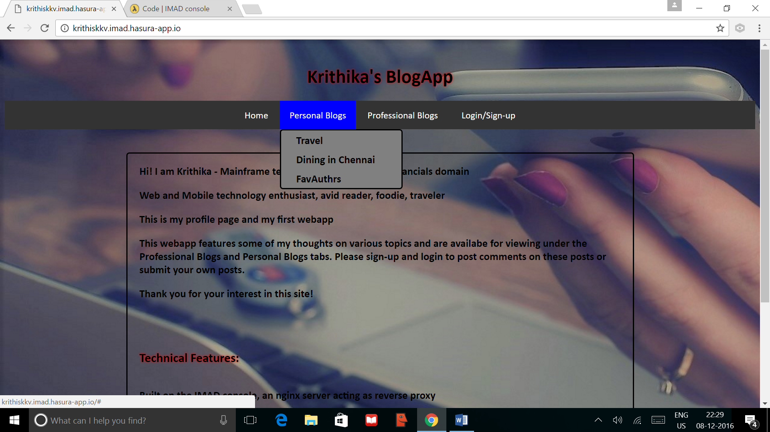
Home Page for non-logged-in users

Slide 3
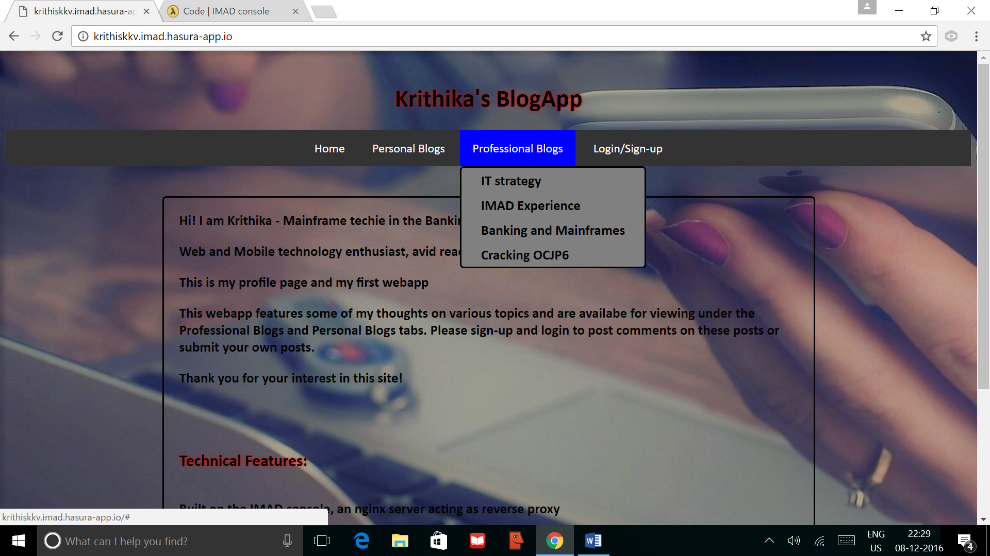
Non-logged-in users homepage contd.,

Slide 4
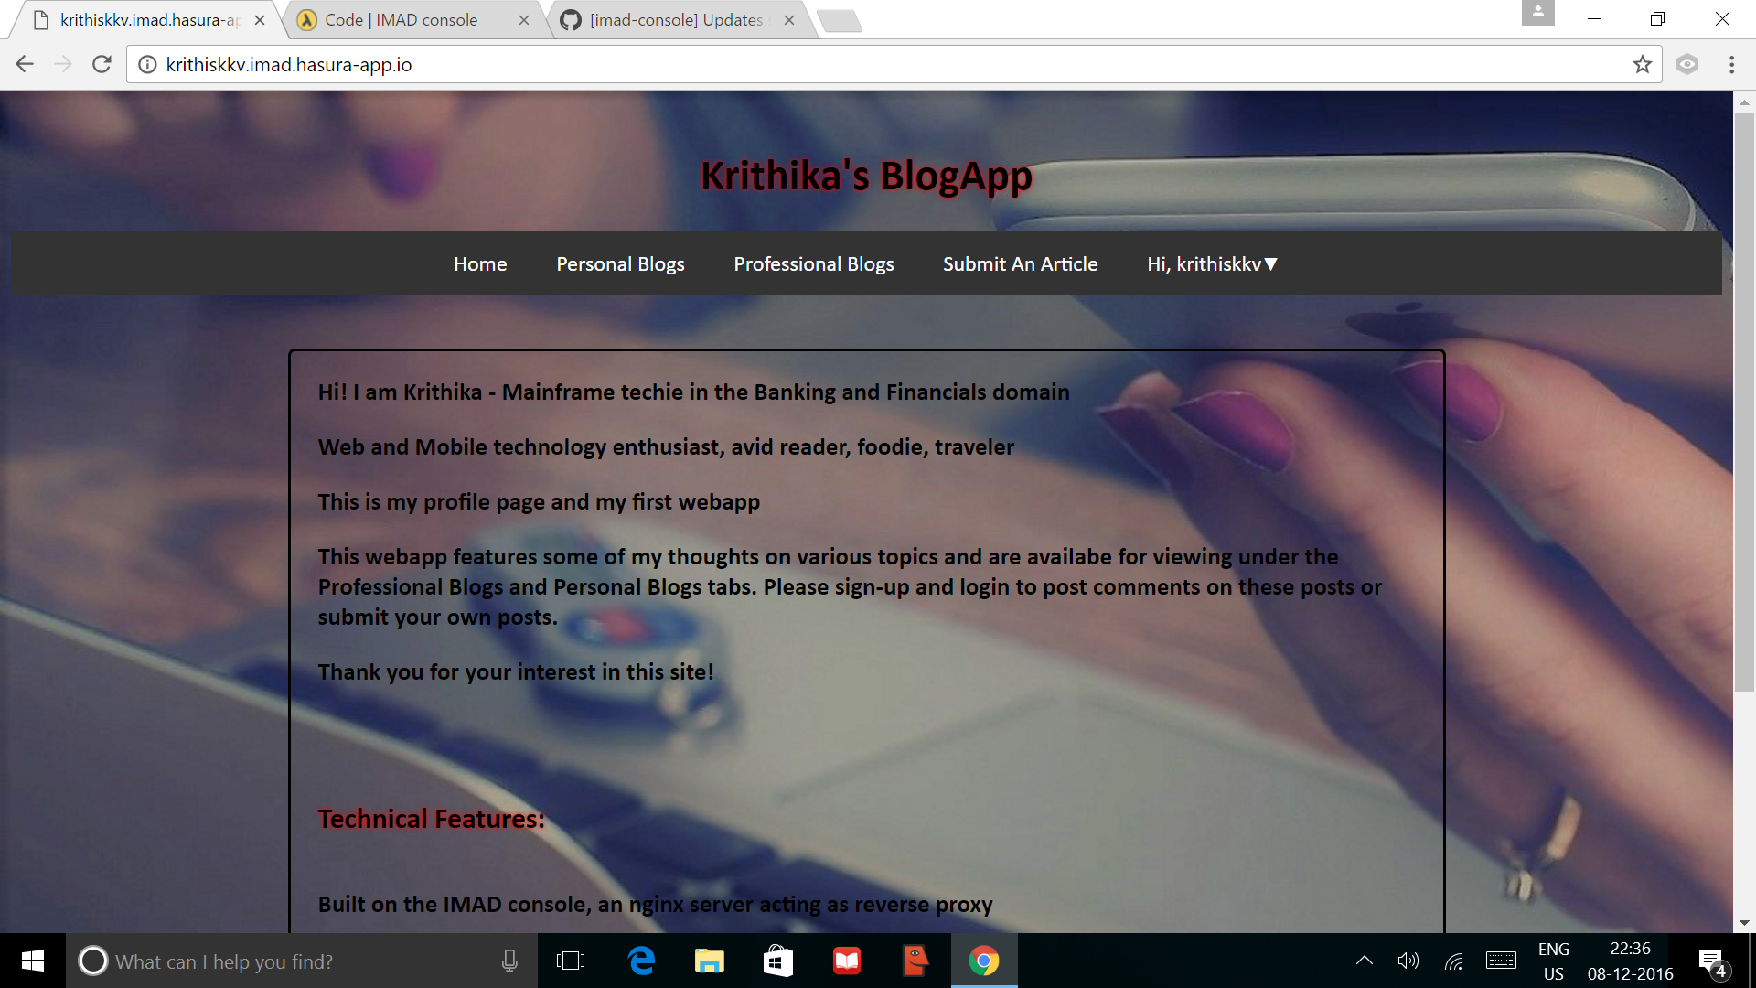
Logged in user homepage

Slide 5
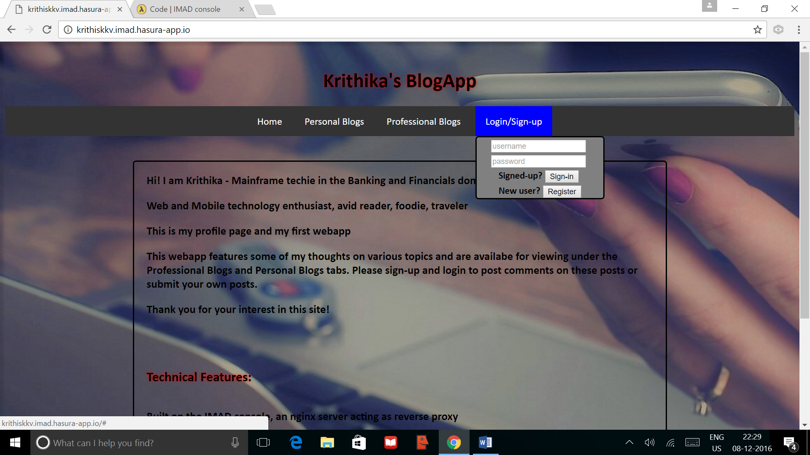
Login/Register page

Slide 6
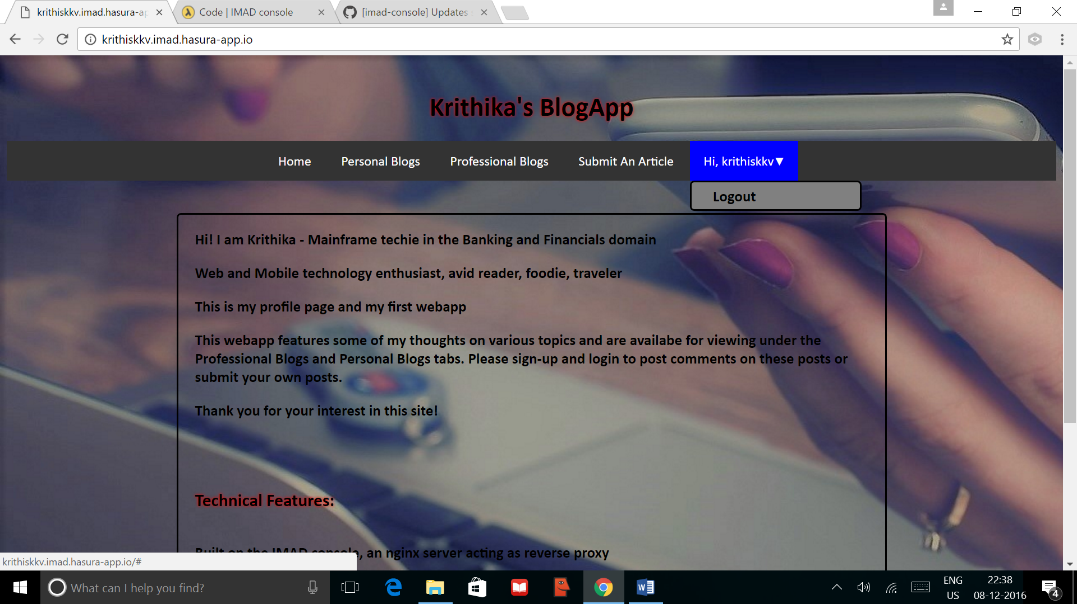
Logout option

Slide 7
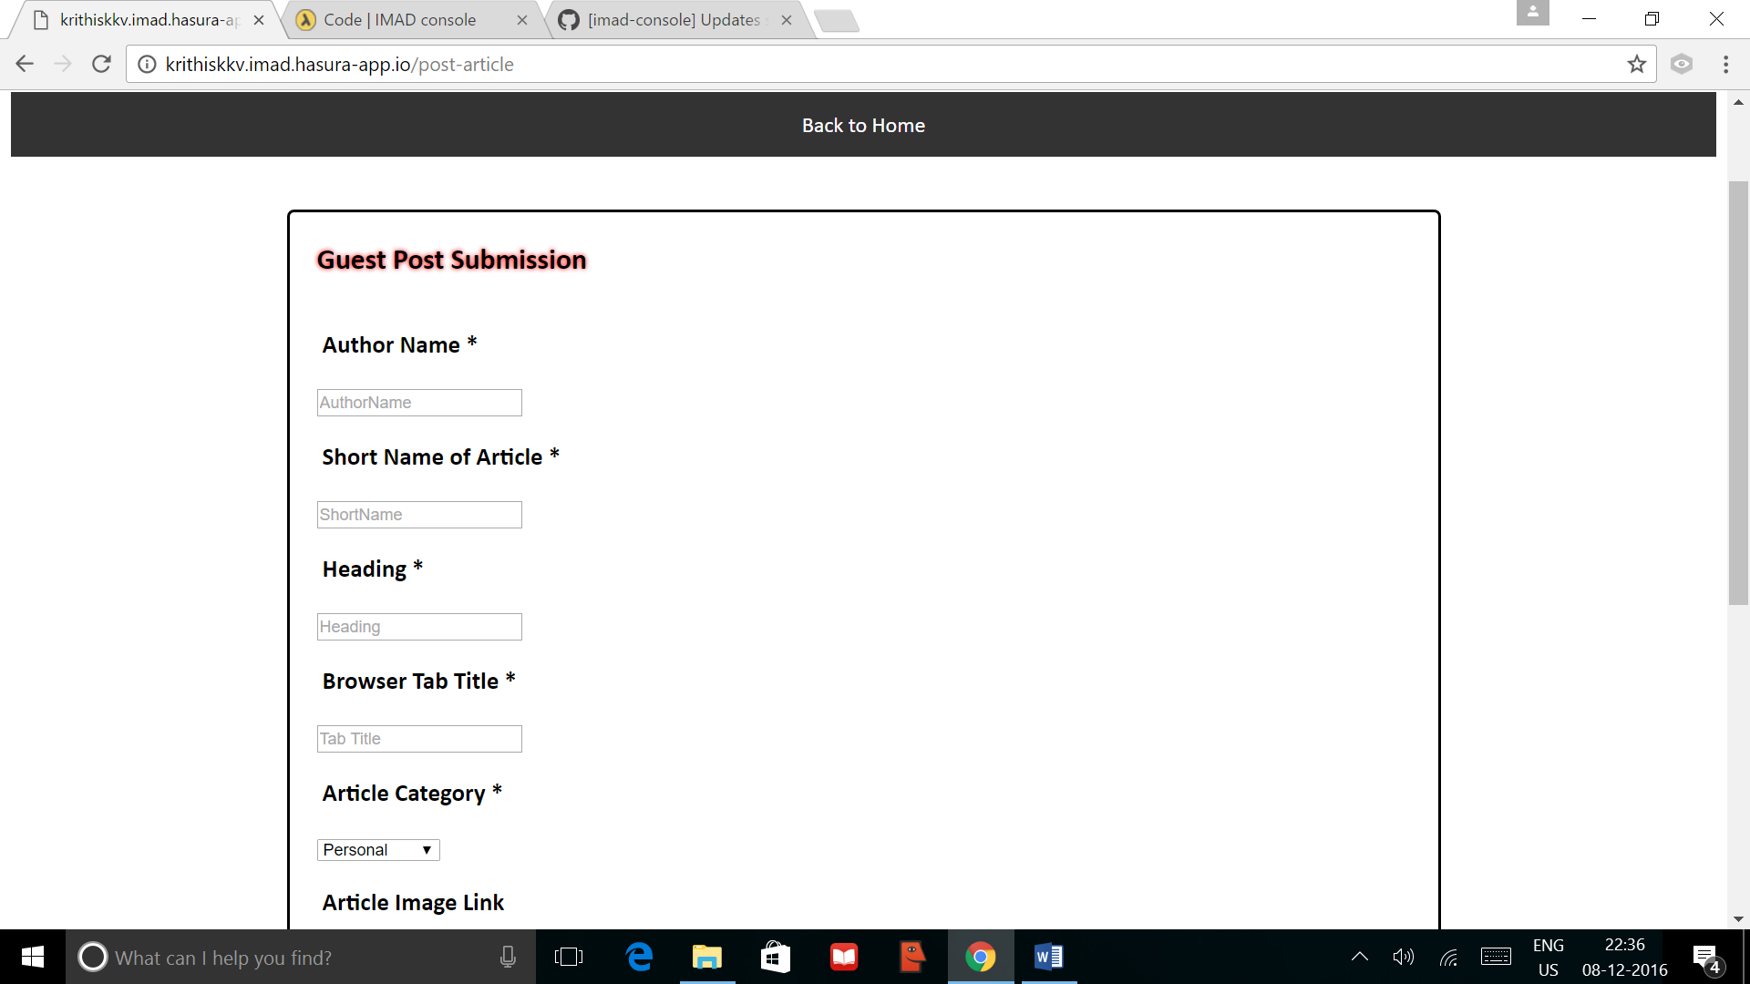
Guest Post submission page

Slide 8
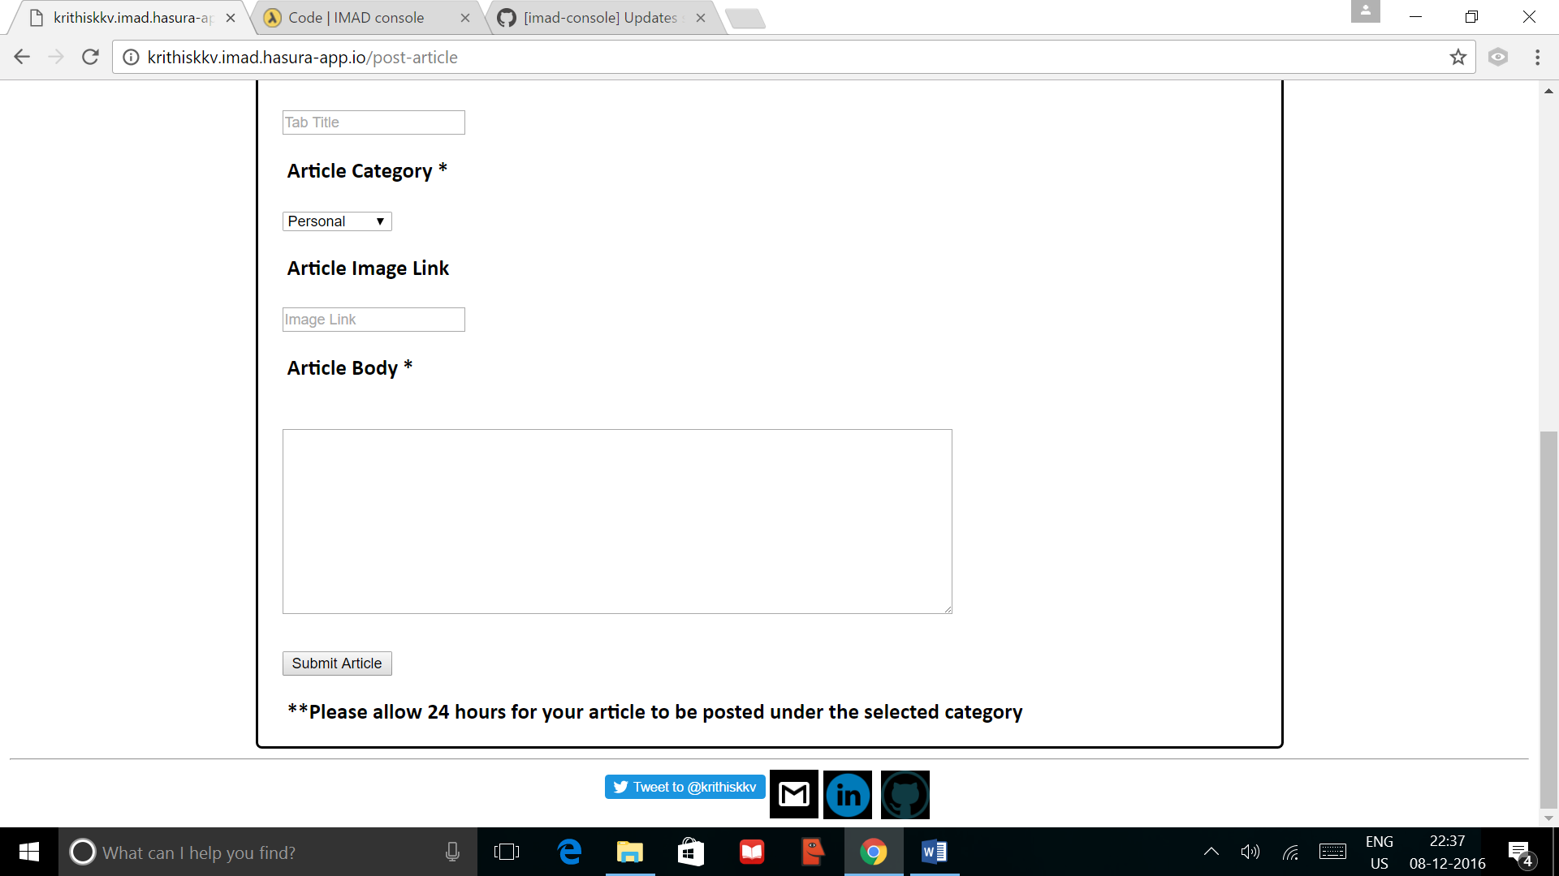
Guest post submission page contd.,

Slide 9
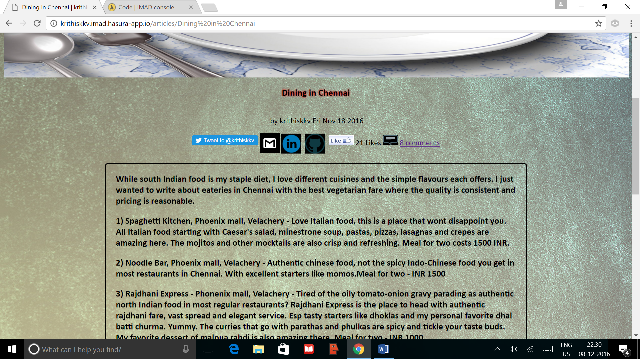
Sample article page

Slide 10
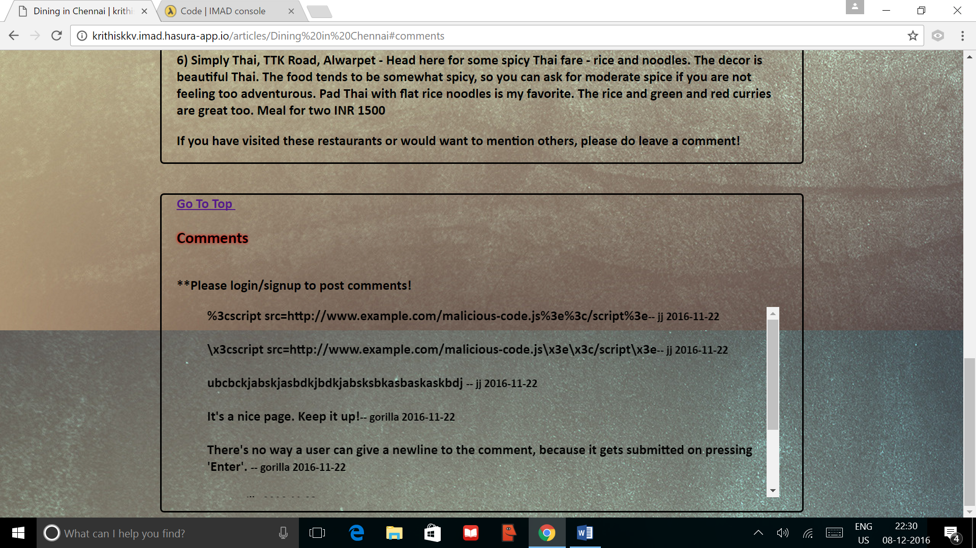
Article comment section for non-logged in users

Slide 11
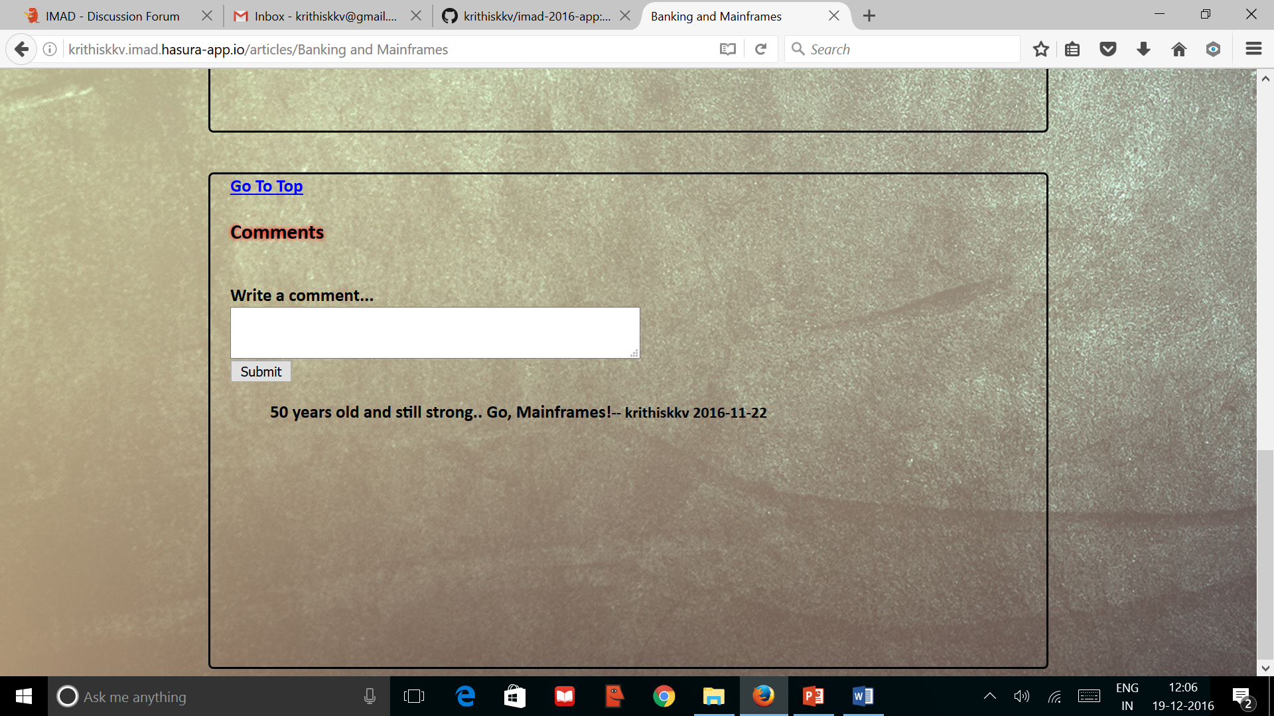
Logged-in user article comment section

Slide 12
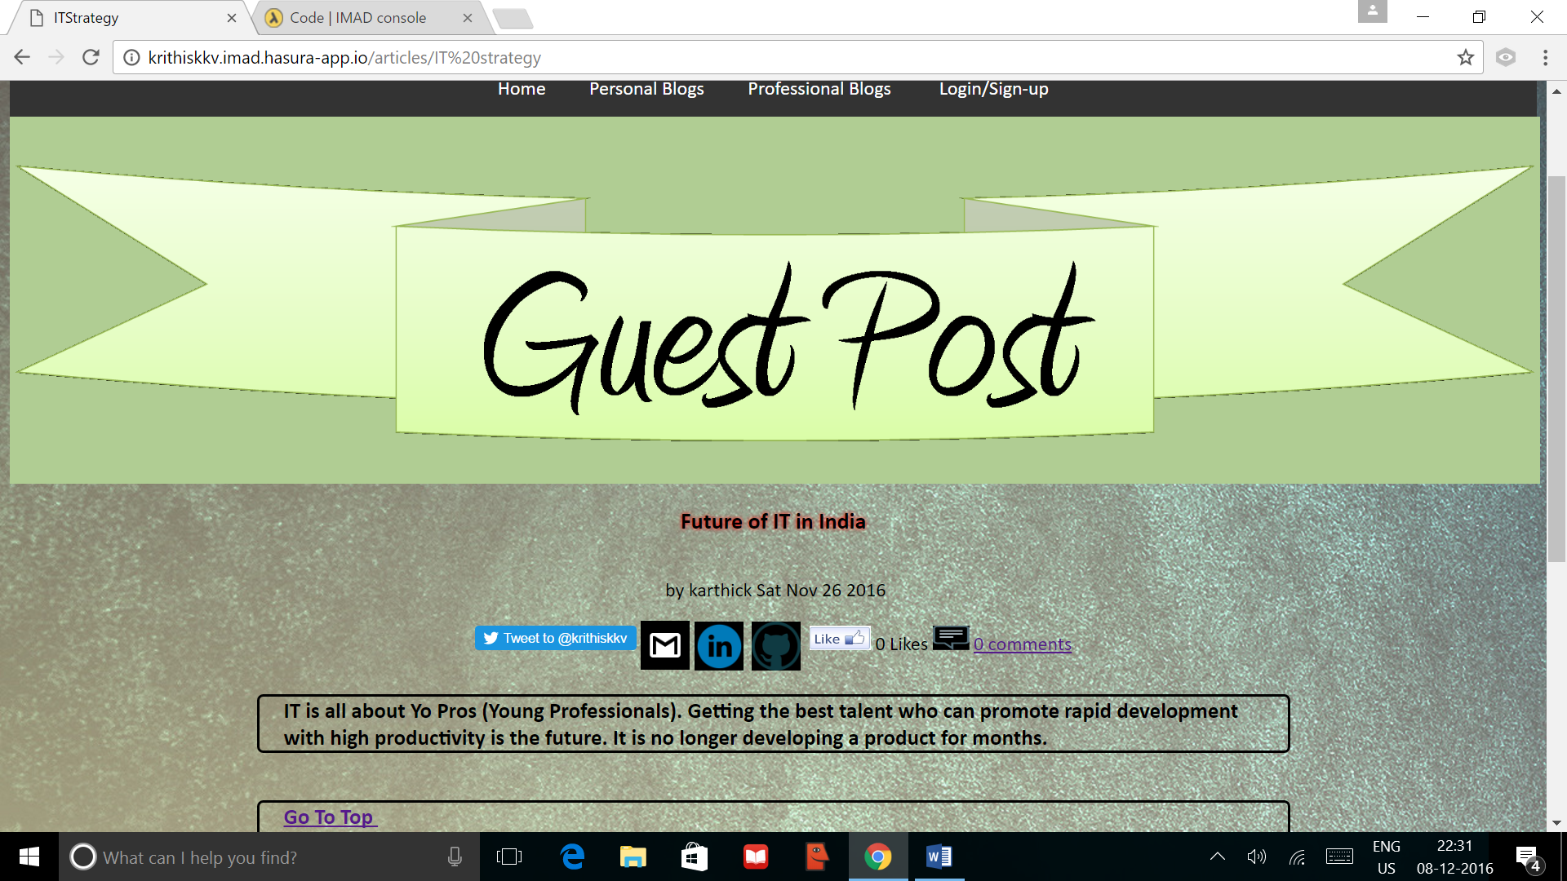
Guest Post

